Slide 1
Week 5 Tasks

Slide 2
Administrivia
Proposals due tonight, feedback by end of weekend
A1, A2 grades are out. 100% if we saw good faith effort
Poll: assignment for sampling?

Slide 3
Related Works phase of project
How does the project go beyond state of the art for your problem?
Not easy! Need to be creative in finding related papers
Many ways to be related
Motivates your problem
Provides a promising approach
Solves your problem, but you can do better
Solves part of your problem, but in different area
Solves different problem, but similar technique

Slide 4
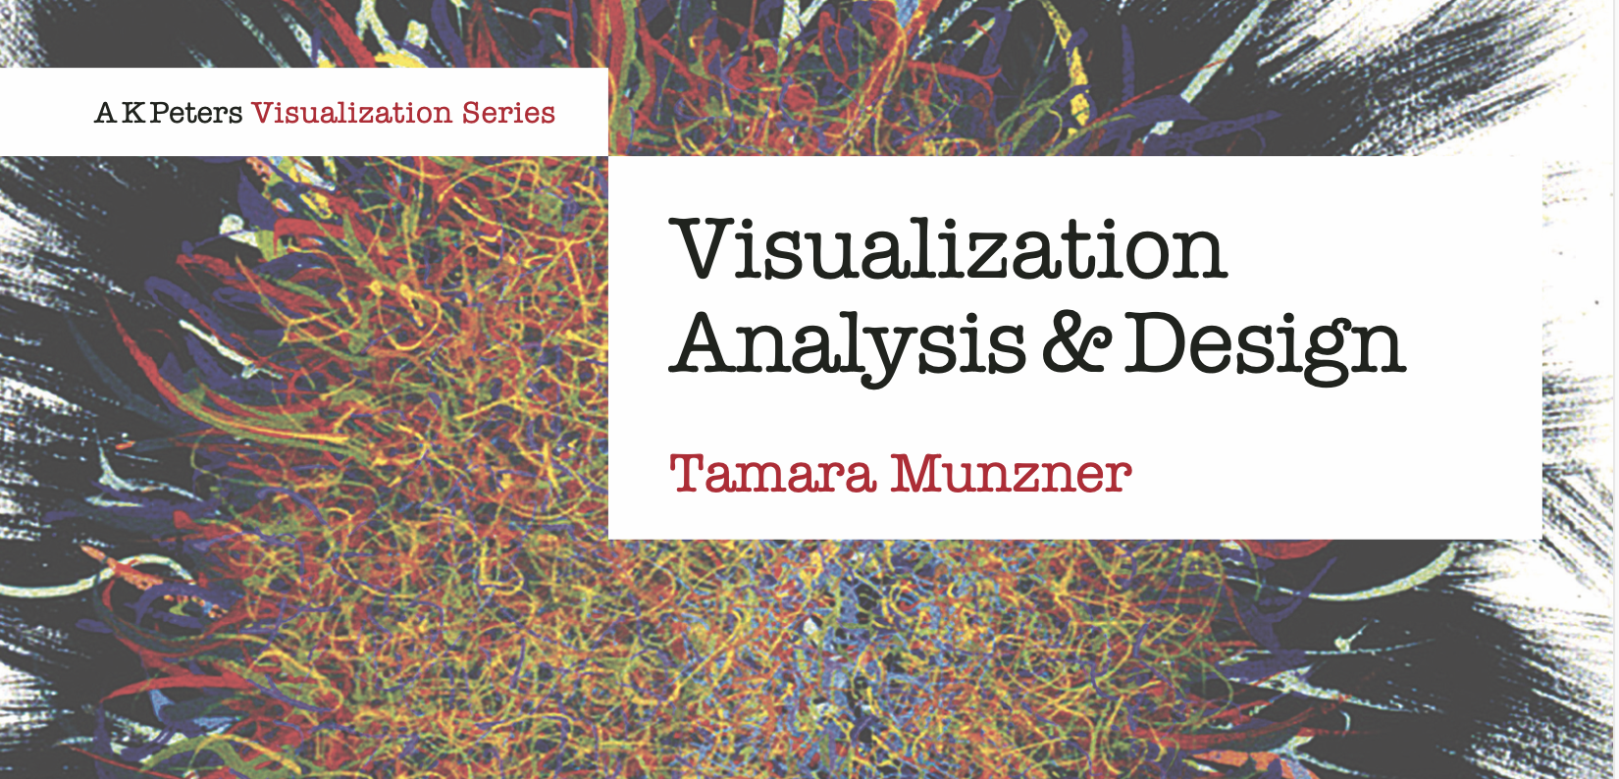
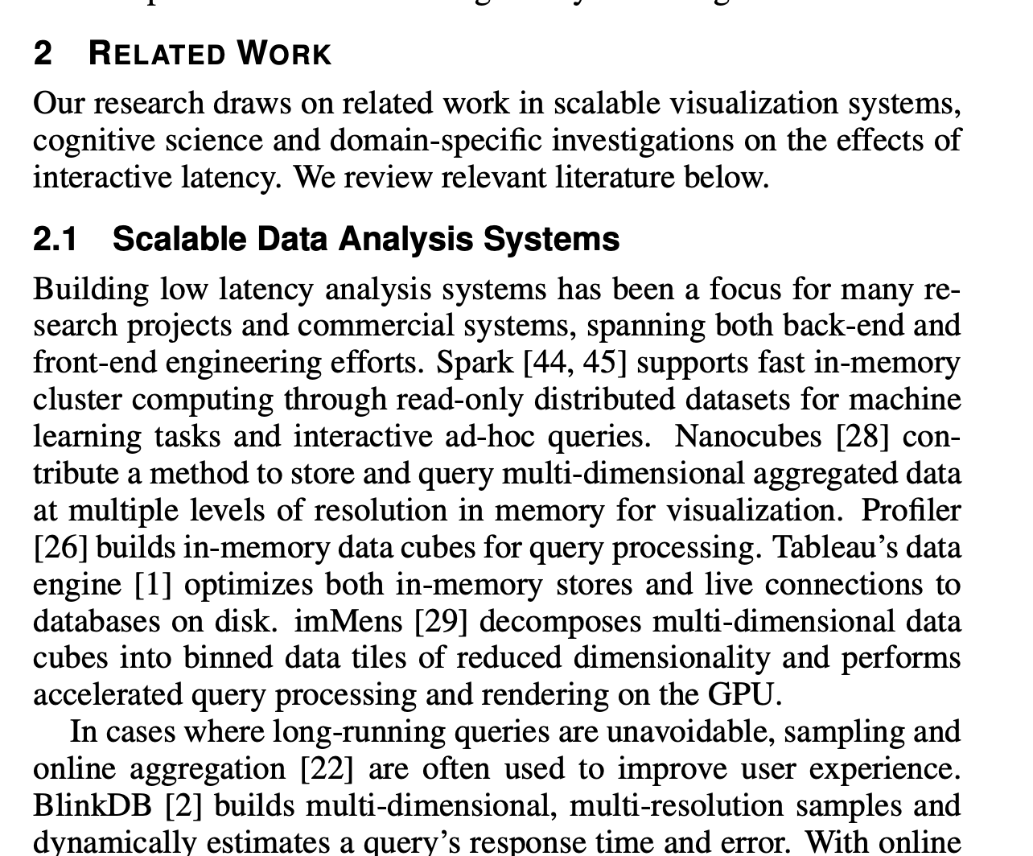
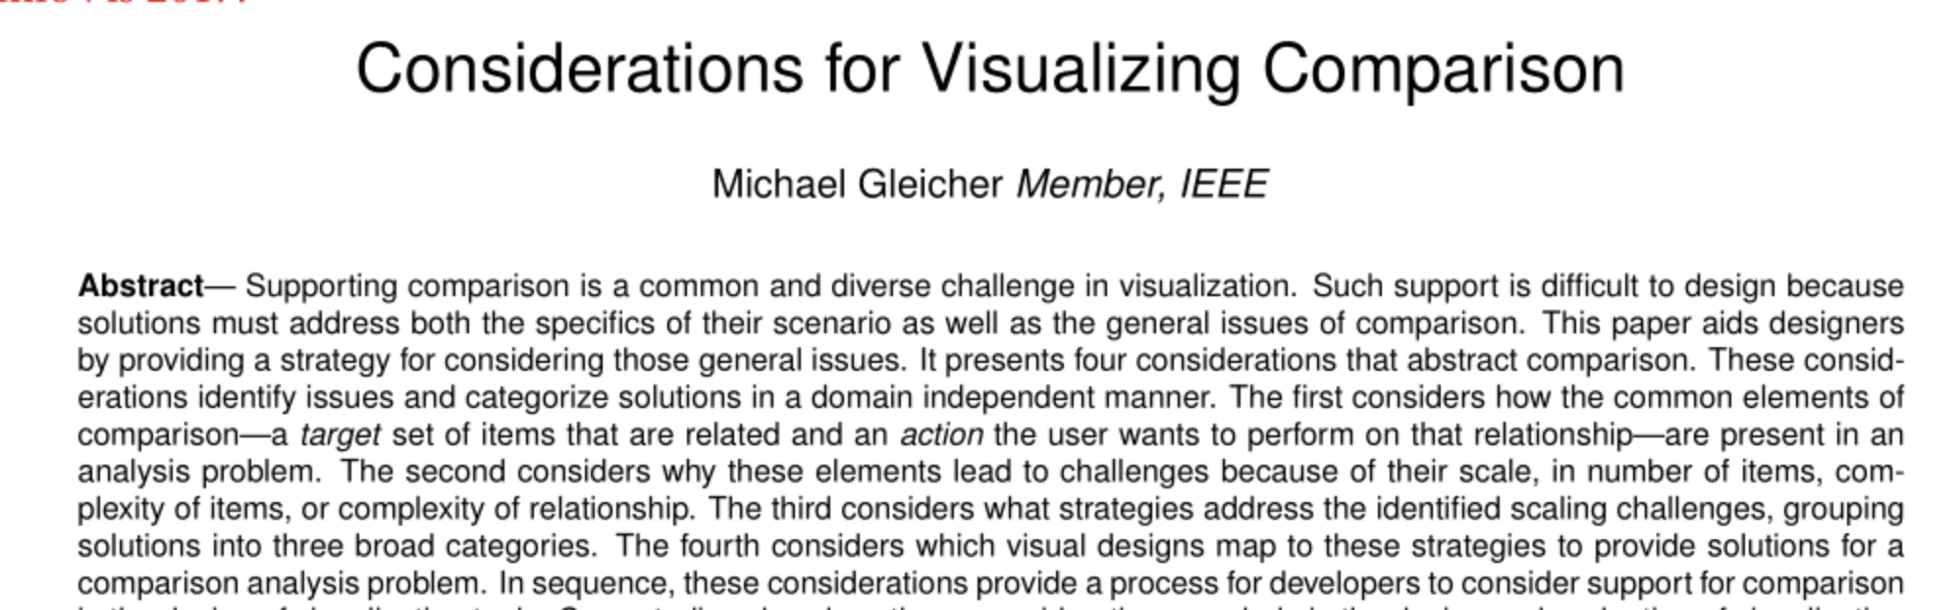
Textbooks, Surveys, Related Works

Slide 5
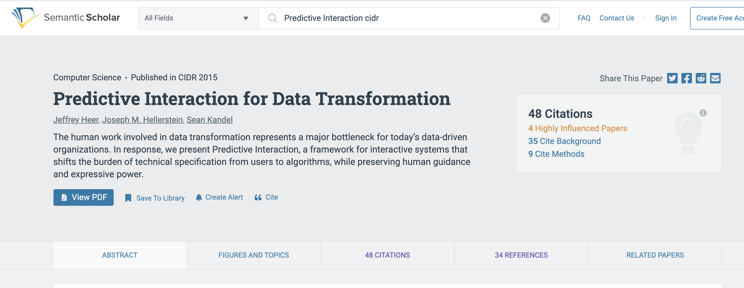
Semantic Scholar

Slide 6
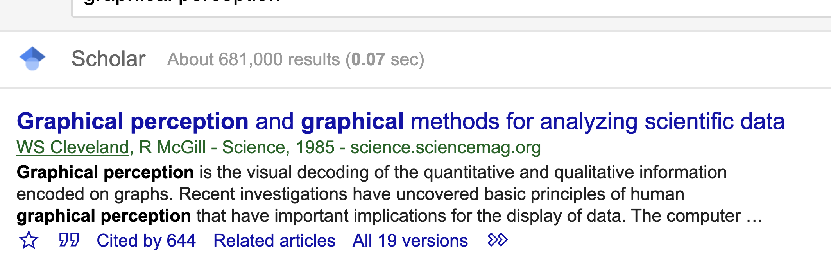
Google Scholar

Slide 7
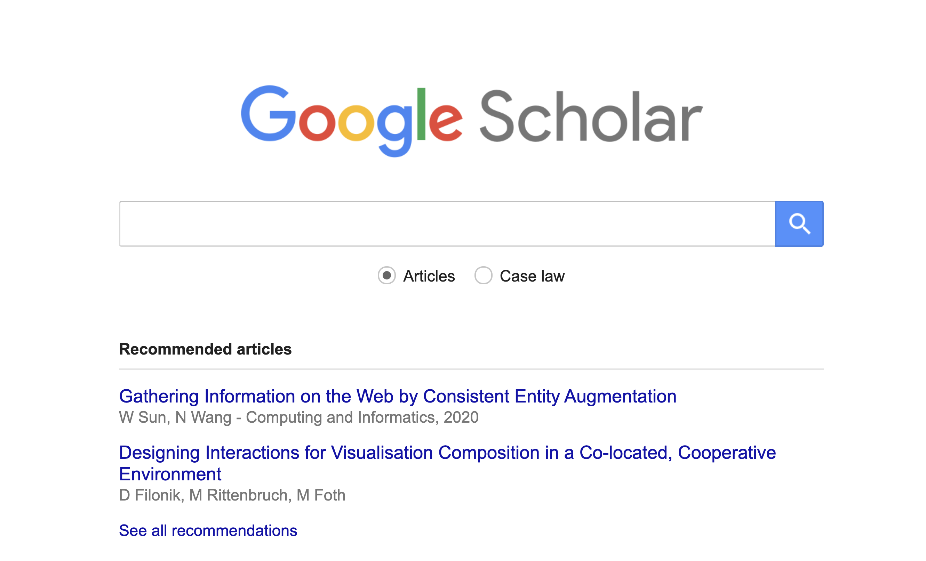

Slide 8
Administrivia
Tamara
Presenter: Alex Price
Scribe: Celia Arsen
Comparison
Presenter Celia Arsen
Scribe: Perrin Anto

Slide 9
Munzner Chapter 1 Discussion

Slide 10
Munzner Chapter 1
Tasks
Effectiveness & the design search space
Validation
What-Why-How

Slide 11
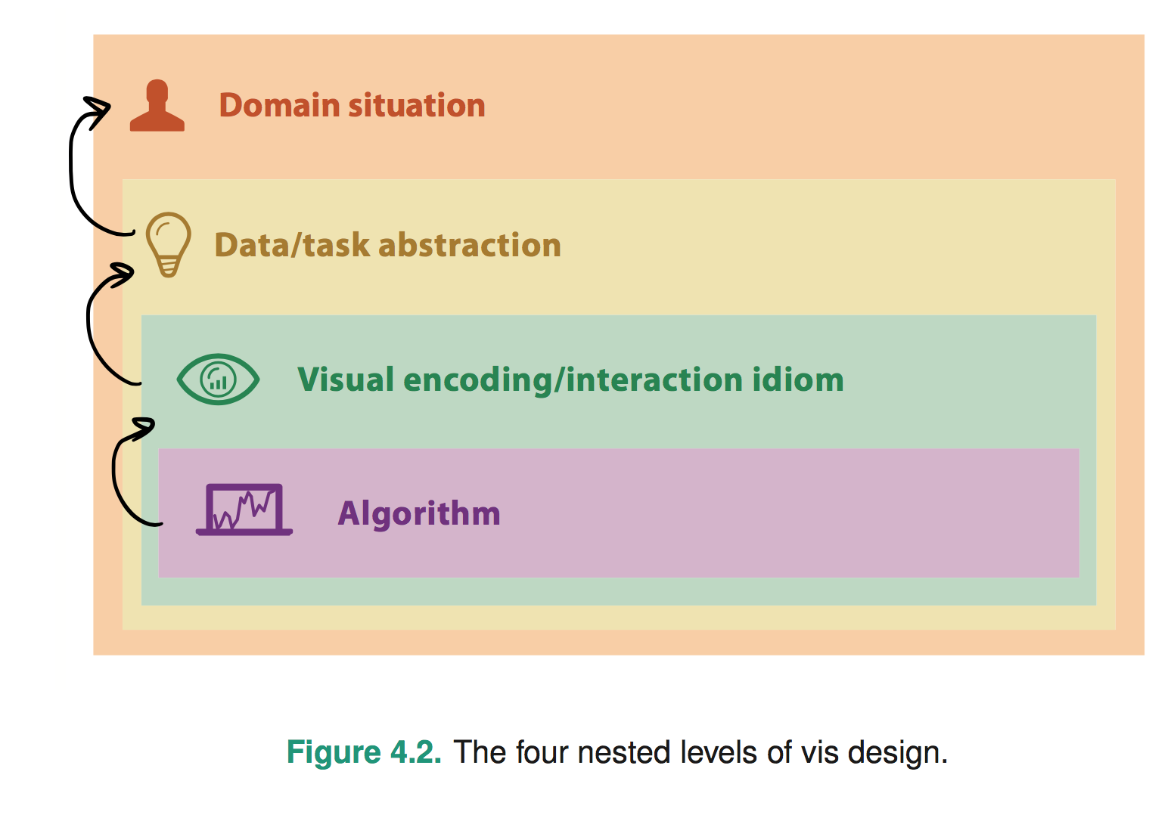
Chapter 4: The Nested Model
Politics, Genomics, Network monitoring, etc
What’s the goal? What data is needed? Talk to users!
Word tree, statistical graphic, etc
Considers perceptual/design issues for task
Computation and performance
Notes:
* early webvis papers soled "lost in hyperspace" by rendering the web's hyperlink topological structures. Not useful, and no idiom/algorithm could solve it, since it only added to user cognitive load

Slide 12
Chapter 4: The Nested Model
Wrong problem. Misunderstood user needs
Wrong abstraction. Showing the wrong thing
The way to show data is ineffective
Code is slow/buggy
Notes:
* early webvis papers soled "lost in hyperspace" by rendering the web's hyperlink topological structures. Not useful, and no idiom/algorithm could solve it, since it only added to user cognitive load

Slide 13
Comparison Paper Discussion

Slide 14
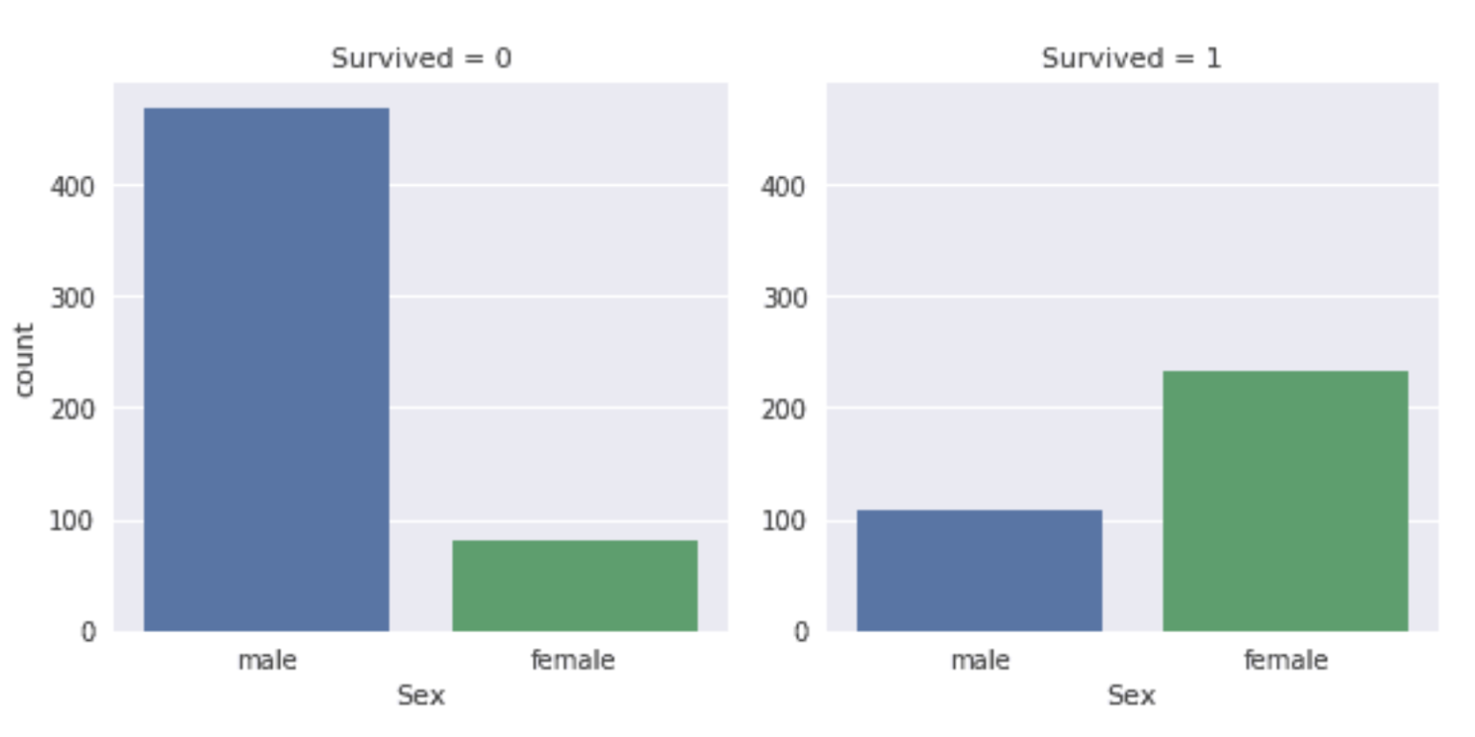
Targets?
Actions?
Naming?

Slide 15
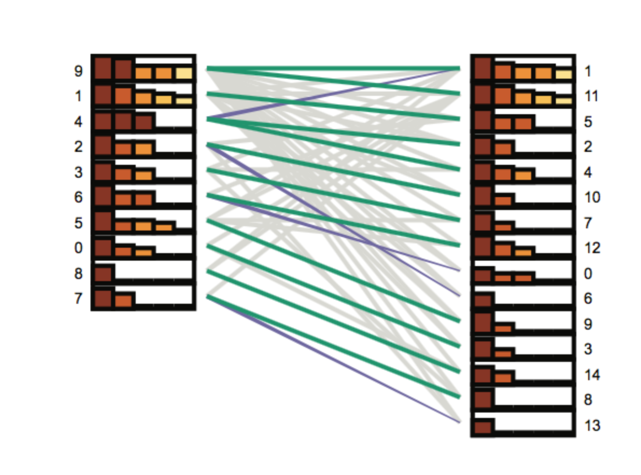

Slide 16
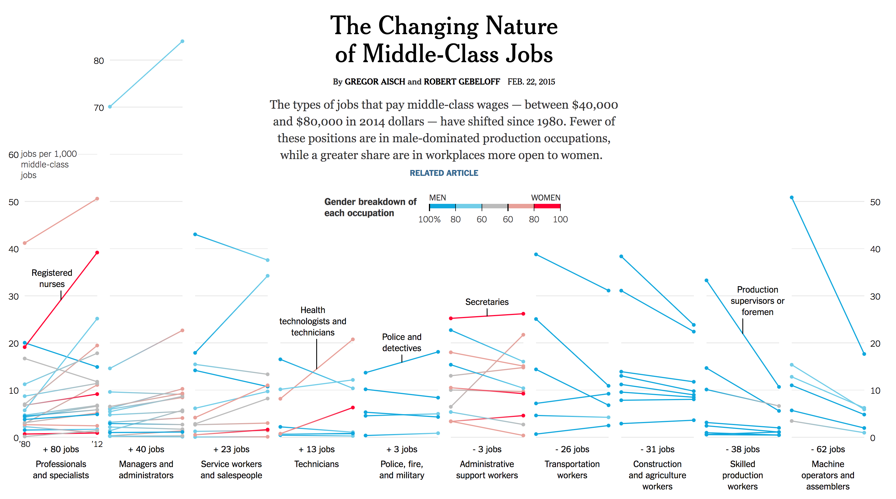
Notes:
https://www.nytimes.com/interactive/2015/02/23/business/economy/the-changing-nature-of-middle-class-jobs.html

Slide 17
Why was this paper written?
What purpose does it serve?

Slide 18
Are comparisons composed of target, action, & naming?
Are there other forms of challenges beyond scalability?
Strategies and Designs
Where does interaction play a role?

Slide 19
An Introduction to Vis
Tamara Ch. 1
Presented by Alex Price

Slide 20
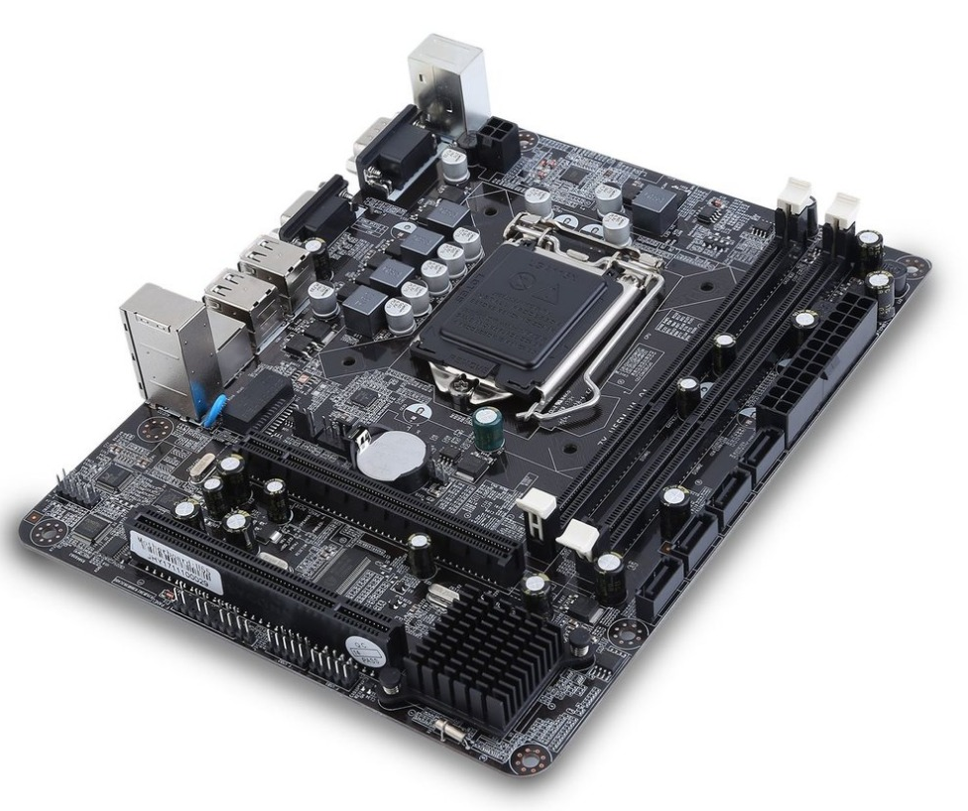


What is Vis?
The design and implementation of computer-based systems that provide visual representations of datasets
The goal of vis is to allow humans to carry out data analysis tasks more effectively
Augmenting human abilities vs. strictly computational decision-making models
Resource Limitations:
Notes:
Computer-based visualization systems: To provide visual representations of datasets that allow people to carry out tasks more effectively.
· Useful when there is a need to augment human capabilities rather than replace with computational decision-making models such as ML/AI
· Determining effectiveness of a specific design in the broad design space
· Resource limitations: Computers, humans, displays

Slide 21
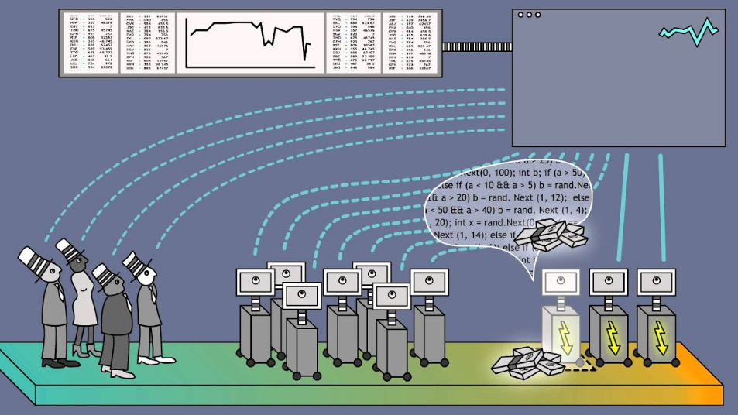
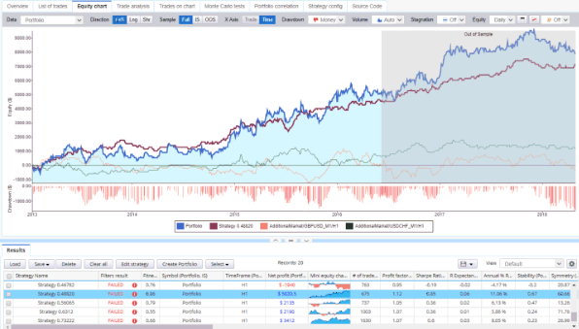
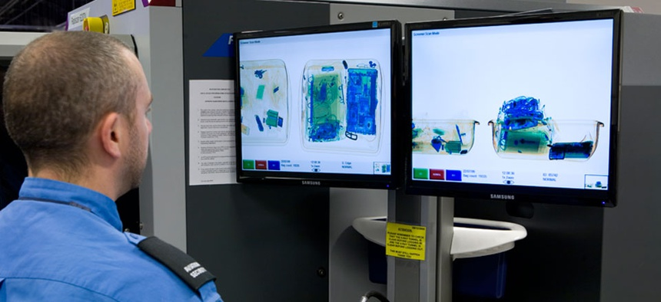
Humans vs. Computers
How well-defined are one’s questions about her data and how many questions need to be asked in what sequence?
Computational (HFT)
Transitional (Backtesting)
Long-term Use (TSA)
Notes:
When people have well-defined questions about their data then purely computational techniques from stats and ML can be applied; however, when there are many questions to ask about the data, it can be important to keep a human in the loop and exploit the powerful pattern detection properties of the human visual system in your design.

Slide 22
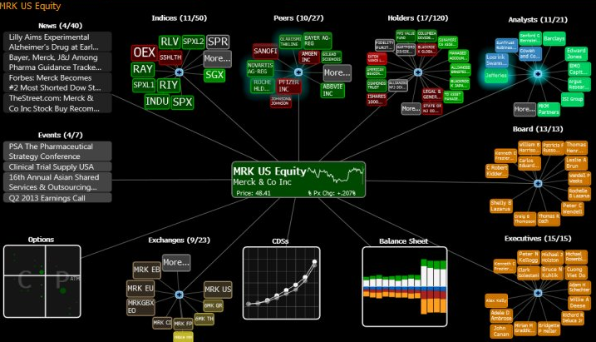
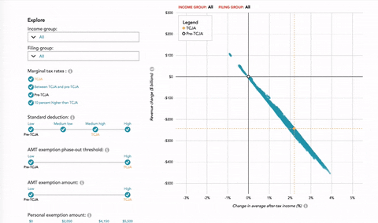
Computers and Displays to Augment Human Analysis
Efficient and precise representation
Dynamic adjustments
Notes:
Inefficient to draw out large, static complex datasets let alone large, dynamic ones that can change over time. As the data changes, easier to have an encoding that automatically generates responses to those changes.

Slide 23
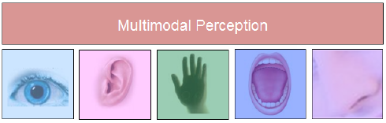

External Representation and Visual Engagement
We use external representations to engage our perceptual system
This allows us to more easily make powerful inferences and engage both short and long term memory
In particular, the visual system is the highest-bandwidth channel to our brains
Parallel processing across entire field of vision
Consequently, sound is processed as a sequential stream
Taste, smell, and touch are similarly inefficient but may but may aid vision in a multimodality that can amplify memory formation and other cognitive function
Notes:
External representations engage our perceptual system that can allow us to more easily make powerful inferences and engage memory, leading to efficient search and recognition of information.
While there are many sensory modalities (image), the visual system has proven to be the highest-bandwidth channel to our brains. Parallel processing across entire field of vision (popout). Consequently, sound for example, is processed as a sequential stream. Taste, smell, and touch are similarly inefficient but may be merged with vision and sound to amplify memory formation.

Slide 24
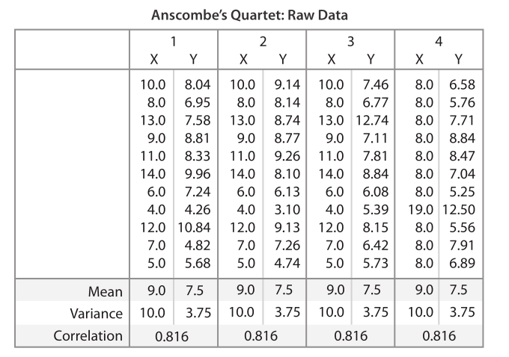
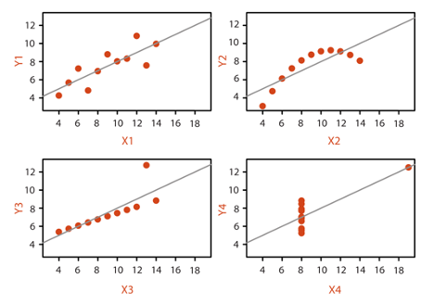

Data Summary vs. Vis
A summary can hide the true nature of the dataset, limiting our analytical ability
Statistical categorization can lead to lost information through summarization

Slide 25
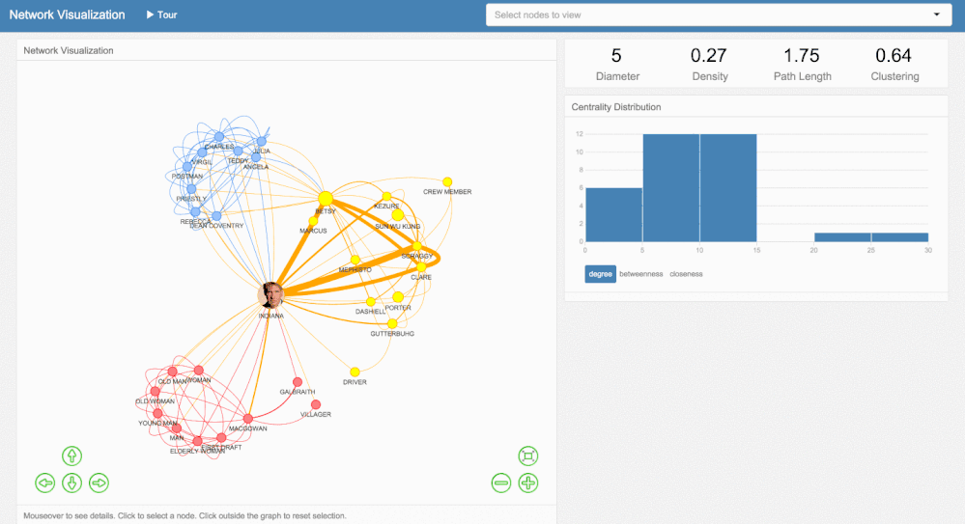
Interactivity
A single, static view can show only one aspect of the data
For large and complex datasets, dynamic view adjustment is crucial
Fast computer graphics have enabled real-time displays
Notes:
When dealing with large and complex datasets, user actions to dynamically change the view can be necessary since single static views can show fewer aspects of a dataset. Fast computer graphics have enabled real-time interactive displays.

Slide 26
Vis Design Space
Is Huge
Picking a specific vis idiom from a plethora of applicable visual encodings is hard
When considering all possible interactions, it is much harder
Systematic Vis Design Thinking
Encode information with spatial position
Facet data between multiple views
Reduce data shown by filtering and aggregation
Notes:
Simple static idioms: Scatterplots, bar charts, and line charts
Interaction then adds another component
Systematic vis design thinking:
· How to encode information with spatial position
· How to facet data between multiple views
· How to reduce data shown by filtering and aggregation

Slide 27
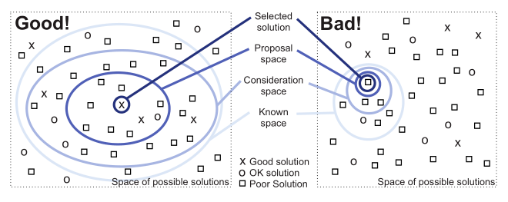
Tasks and Effectiveness
To achieve the goal of vis and bolster effectiveness, one must aim to support user tasks:
Consider specific user data analysis tasks
Consider the kind of data users are analyzing
There are always tradeoffs:
Any specific depiction of data is an abstraction where choices are made about which aspects to emphasize and deemphasize
In design problems, it is more important to optimize than to satisfy
Effective Design Framework
Possible Space: Set of all possible solutions
Known Space: Set of all possible solutions known to you (hopefully this class enlarges this space for us)
Consideration Space: Solutions actively considered
Proposal Space: A smaller solution set to be considered in detail
Selected Solution: The most satisfactory from the proposal space
Validation of the selected solution is difficult because there can be many design goals that are loosely defined and highly subjective

Slide 28
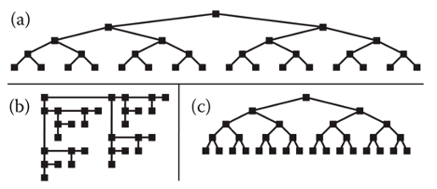
Resource Limitations
In creating a vis system, we must consider:
Computational Capacity: computer time and memory are limited resources, big datasets may not fit into core memory, computational complexity of algorithms needs to be understood and monitored
Human Perceptual and Cognitive Capacity: Memory and attention are limited resources, change blindness where large changes can go unnoticed if we are focusing on something else in our view
Display Capacity: Need to be cognizant of screen resolution and information density
We also need to consider scalability in a world of big data

Slide 29
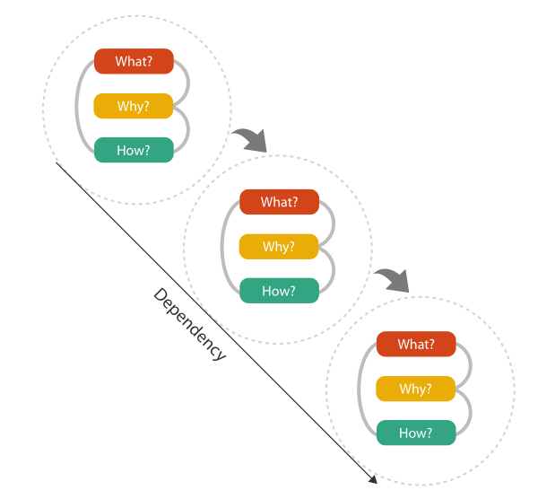
Analyzing for Effective Vis System Design
What data does the user see?
Why does the user intend to use a vis tool?
How are the visual encodings and interaction idioms constructed?

Slide 30
Discussion

Slide 31
Considerations for Visualizing Comparison
Michael Gleicher

Slide 32
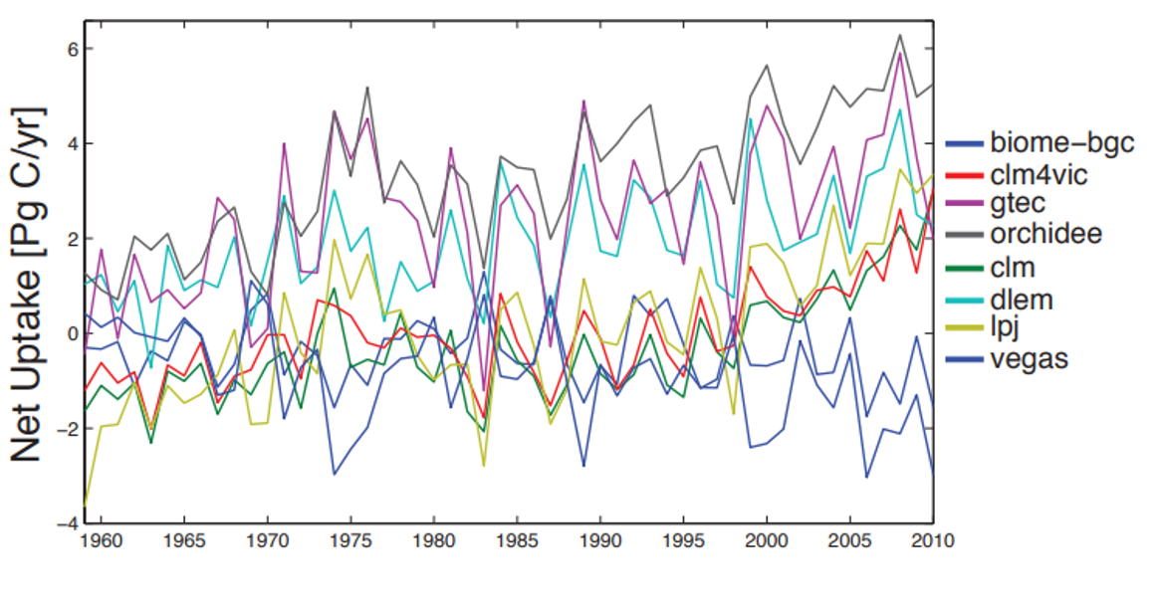
Problem
Comparing objects is one of the most common analytical tasks we perform
Lacking a scalable and detailed framework for designing comparison tasks
Notes:
- He does a semi-automated literature review to try to point out how important comparisons are when it comes to processing information
- There should be a generalizable approach to solving a problem like this

Slide 34

Context – Importance of Comparison
Notes:
- There is a historical context to this problem
It is much more complicated than “finding differences”…for example
Compare within and between the trips
Existing generalized frameworks have no breakdown beyond “comparison,” when comparison is actually done in many different ways, depending on the task

Slide 35
Previous Literature
Focus on specific visual designs
(Tufte, 1990)
Provide solutions for a specific data type
(Graham & Kennedy, 2010), (Pagendarm & Post, 1995), (Urness, et al., 2006), (Verma & Pang, 2004), (Gleicher, et al. 2011)
Measure user performance on comparative tasks
(Livingston & Decker, 2011), (Alper, et al., 2013), (Gleicher, et al., 2013), (Fuchs, et al., 2014)
Draw from perceptual science
(Farell, 1985), (Resnik, 2002), (Franconeri, 2013), (Larsen & Bundesen, 1998), (Larsen & Bundesen, 1978)
Notes:
Small multiples
For ordinal data, or neural networks it makes sense to use this type
Give users a task and see how well they respond → given different bar charts, how quickly can a user correctly respond to a question, or how accurately can they respond to a question
Cognitive science

Slide 36
Contributions
A framework that abstracts comparison challenges and the approaches that support them

Slide 37
Four Considerations
Identify comparative:
Elements
Challenges
Strategies, and
Designs

Slide 38
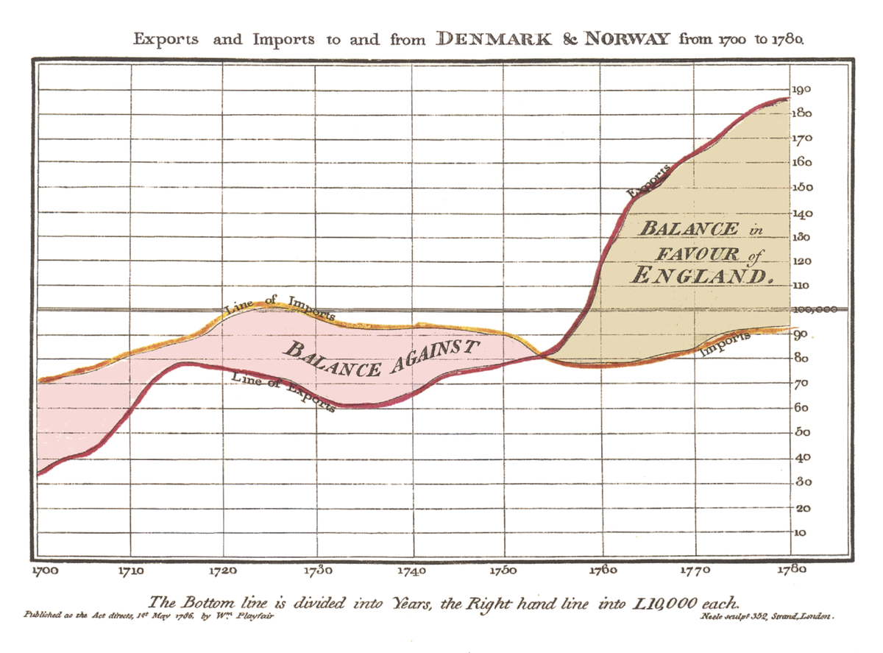
(1) Identify Comparative Elements
Target is a set of items that are related
The action we want users to perform on that relationship
Notes:
Target is the amount of imports and the amount of exports in England in the 18th century
The action is that we want users to compare the difference between imports and exports over time
Sometimes, that

Slide 39
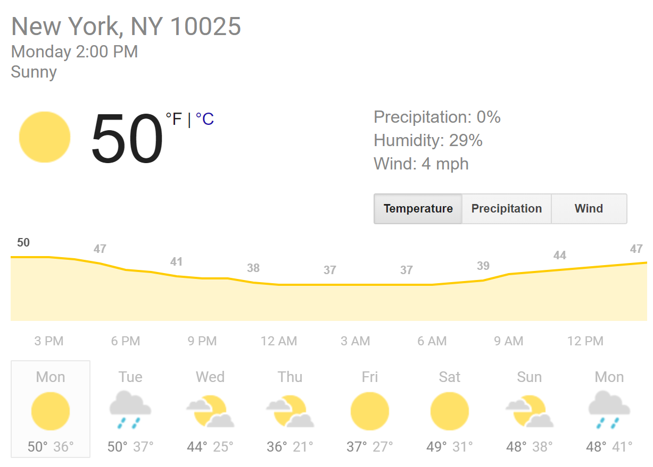
(1) Identify Comparative Elements
Some targets are implicit, or “hidden”
Notes:
-explicit is the temperature each day
-implicit is our knowledge of typical weather in NYC in February

Slide 40
(1) Identify Comparative Elements
Actions include:
Identify relationships
Measure/quantify/summarize relationships
Dissect a relationship
Connect relationships
Contextualize a similarity/difference
Communicate/illuminate a relationship
Notes:
--verbs are more complex than just identify a relationship

Slide 41
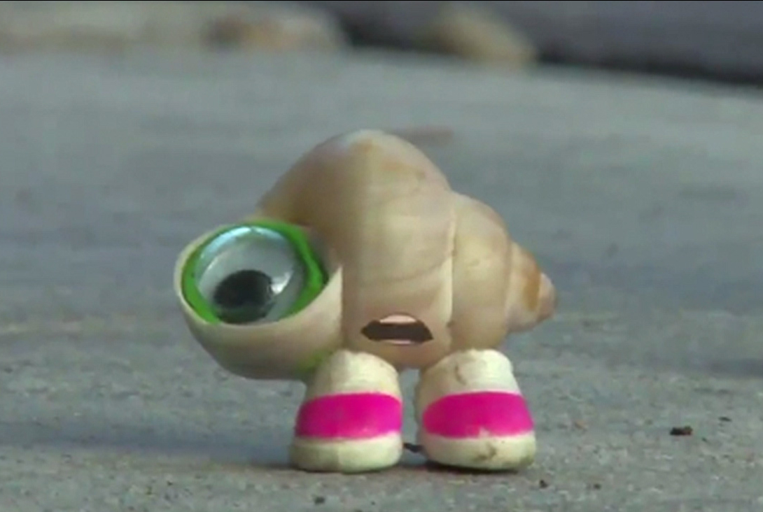
(1) Identify Comparative Elements
At the heart of quantitative reasoning lies a single question: Compared to what? – Tufte
Notes:
-Calling a task a comparison is not sufficient

Slide 42
(2) Identify Comparative Challenges
Three aspects that make comparative data challenging:
a. The number of items being compared
b. The size or complexity of individual items
c. The size or complexity of the relationships
Notes:
-draw axes on the board
-They typical are linear, but don’t need to be.
-We can imagine tasks that lie squarely along any given axis
-tools usually make a compromise between these three
-example of diff in unix
-

Slide 43
(3) Identify Comparative Strategies
Sequential scan
Ordering is important
Helps us understand numerous/large items
Select subset
Don’t show all of the data
Helps us understand numerous/large items
Summarize (somehow)
Notes:
-strategies should address the challenges of the tasks, and the perceptual strains they put on the user

Slide 44
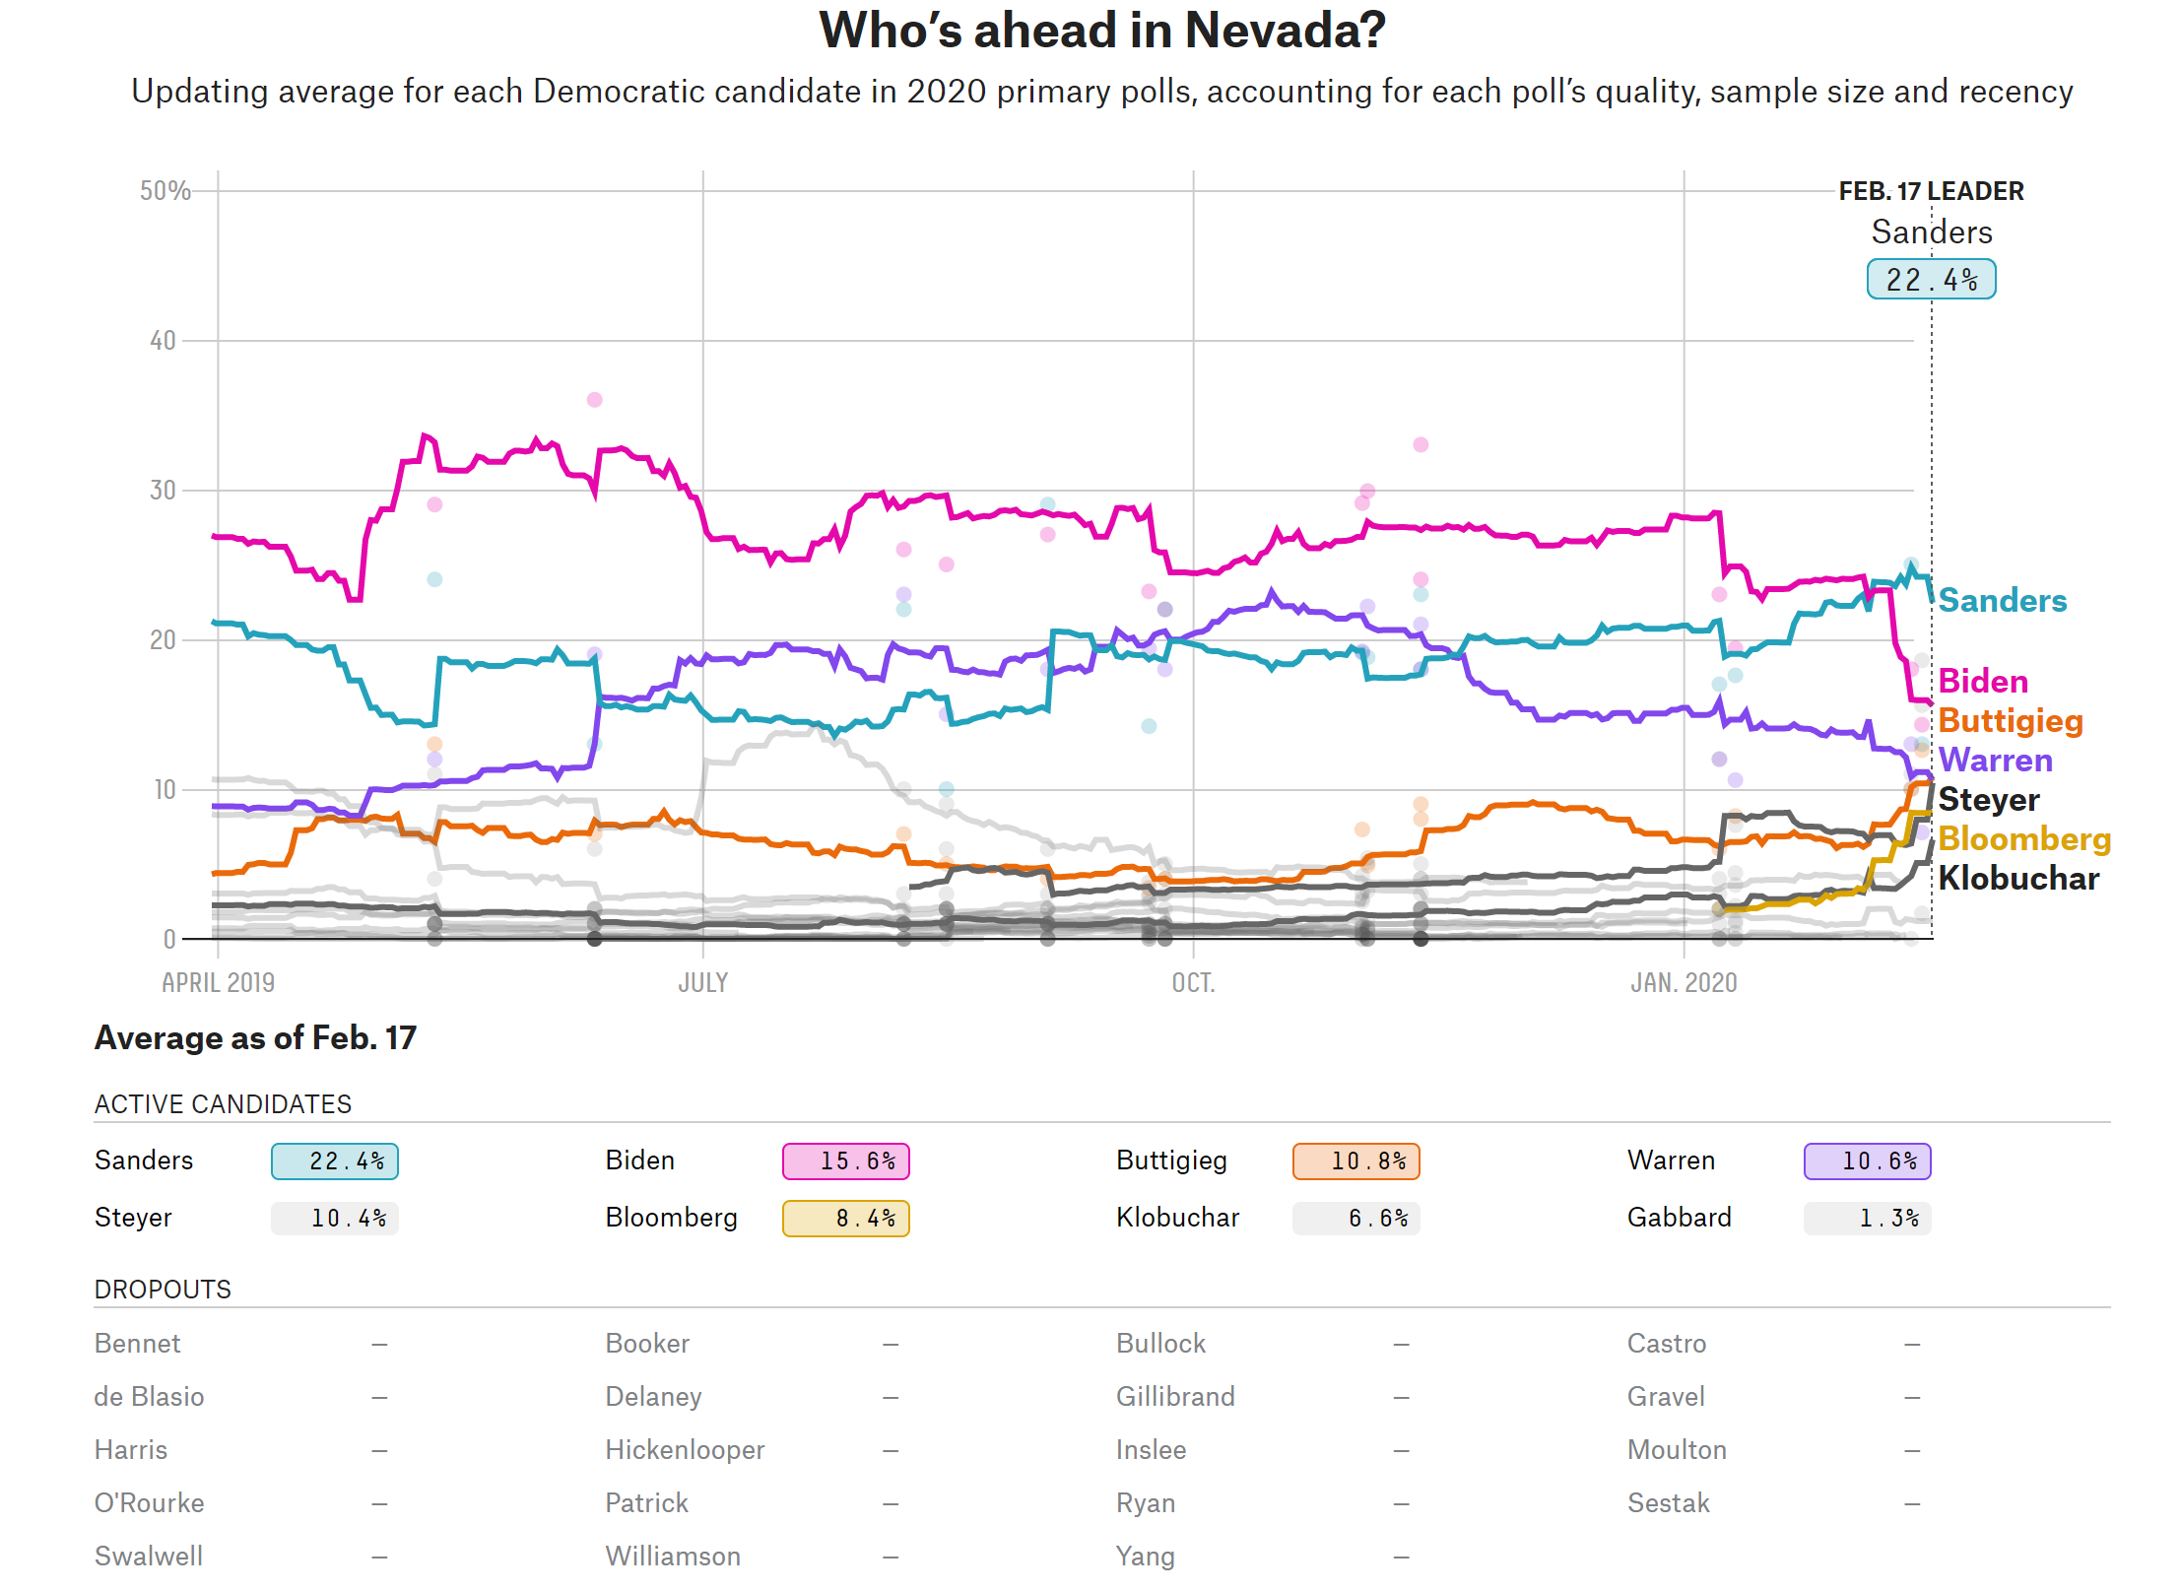
(3) Identify Comparative Strategies
Notes:
-Examples of sequential scan and select subset
-Draw example on board of summarize with box-plot

Slide 45
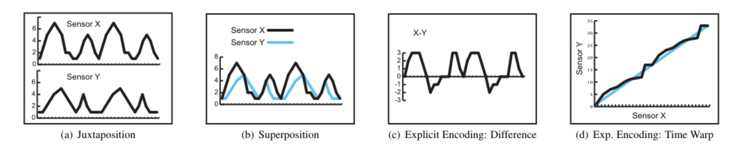
(4) Identify Comparative Visual Design
Juxtaposition
Superposition
Explicit encoding
Notes:
-interactions and encodings

Slide 46
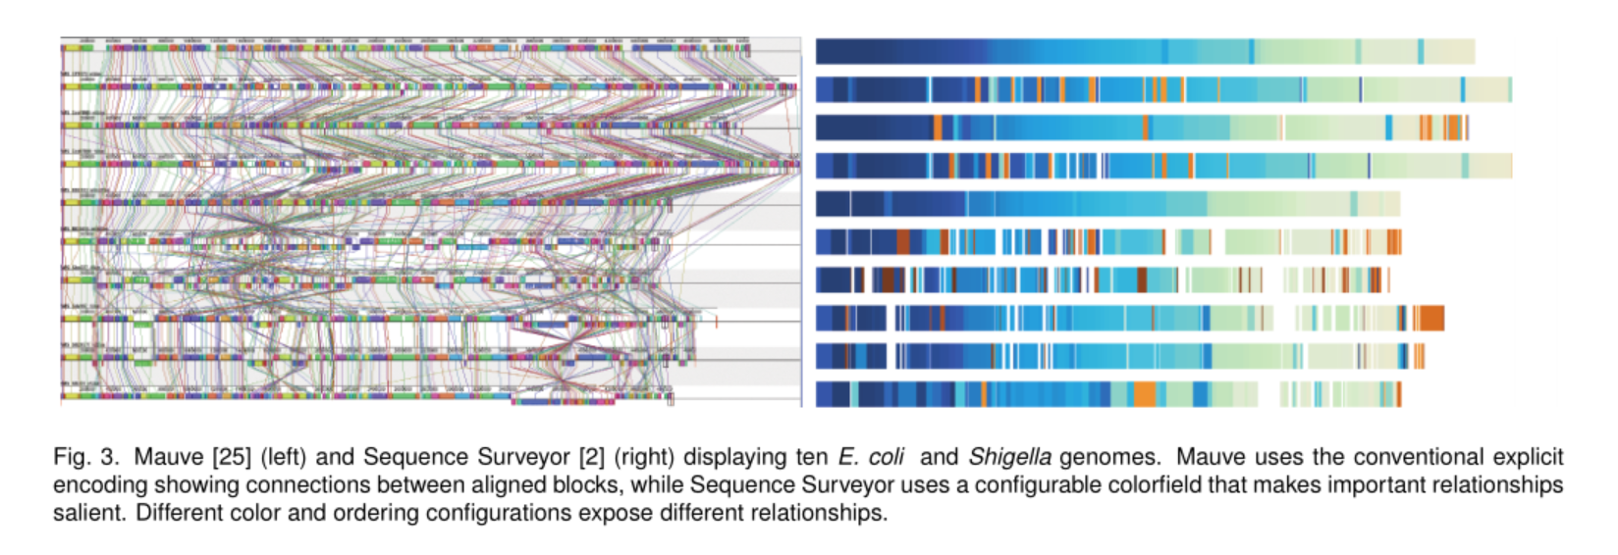
Evaluation – (1) Sequence Surveyor
Notes:
-Balance the three strategies (scan, subset, summarize)
- Opted for juxtaposition

Slide 47
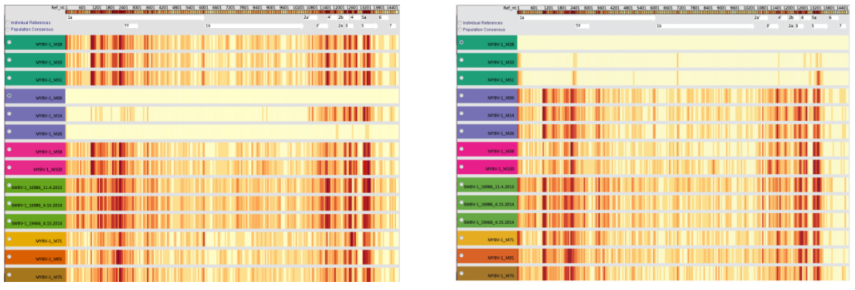
Evaluation – (2) LayerCake
Notes:
-similar problem, but needed to be able to group items together

Slide 48
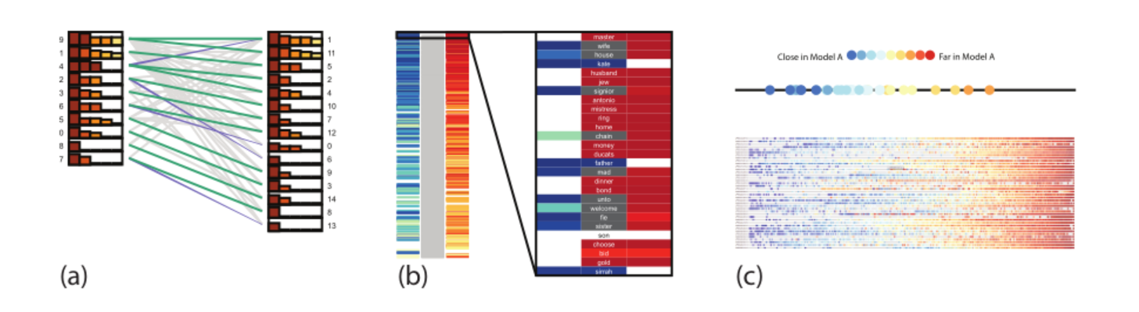
Evaluation – (3) Topic Model Comparison
Notes:
-large implicit factor
-allows to dissect
- I don’t think I’m really sold on this method of proof by case study, especially when the contribution is so abstract. Of course the autor can show how it was useful to him, but I think it woudl be more useful to show that this framework can help somewhat naive designers make decisions

Slide 49
Future Work
Others have cited this work since its publication
In designing their own tools
Testing hypotheses with crowdsourced user study

Slide 50
Discussion
Do you think this paper made a major contribution?
Were the examples sufficient “proof”?
Is this framework comprehensive?

